Slide 1
Chapter 9: Detecting and responding

Slide 2
Cell signalling in context
What do these three things have in common?
The ability to catch a ball
The growth of a tadpole to a frog
The production of vasopressin in response to hypothalamic detection of low water
They all rely on cell signalling, which involves
production of a signal by one type of cell
transport of the signal through the extracellular space
reception of the signal by a target cell
transduction of the information within the cell
and an appropriate response by the target cell.

Slide 3
Evolution of cell signaling systems
Cell signalling in context
Early prokaryotic cells lived in a sea containing many charged ions including Ca²⁺,K⁺, Na⁺ and Cl⁻.
Even though the ions are small, they are charged, and cannot pass through the plasma membrane.
Organisms evolved ion channels to control the passage of ions across their cell membrane.
The difference between intracellular and extracellular ion concentrations can be 10 000 fold. This difference can be a powerful tool.

Slide 4
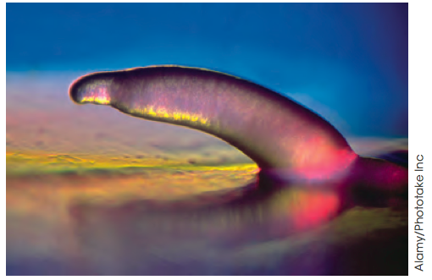
Evolution of cell signalling systems
Cell signalling in context
Unicellular organisms evolved signalling systems to communication with each other.
Intercellular signalling may have paved the way for the evolution of multicellular organisms.
For example, when faced with starvation, the normally unicellular slime mould Dictyostelium secretes signalling molecules that attracts other moulds by chemotaxis.
Thousands of cells can group together and form a slug that can move in search of food.

Slide 5
Cell signalling in multicellular organisms
Cell signalling in context
Being a multicellular requires the ability to coordinate many different cells.
Cells become specialised to perform different functions.
There are approximately 200 types of cells in humans and all of them arise from stem cells.
Cells become specialised through the process of differentiation.
Keeping cell numbers in balance is controlled by signals that
Stimulate cell division
Stimulate cell death by apoptosis

Slide 6
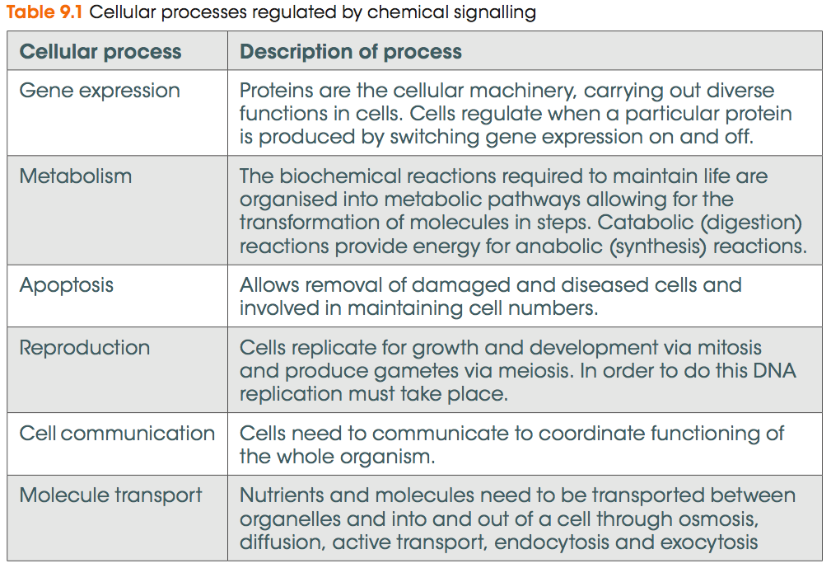
Regulating cellular processes
Cell signalling in context
Cell signalling regulates various cellular processes, including the following:

Slide 7
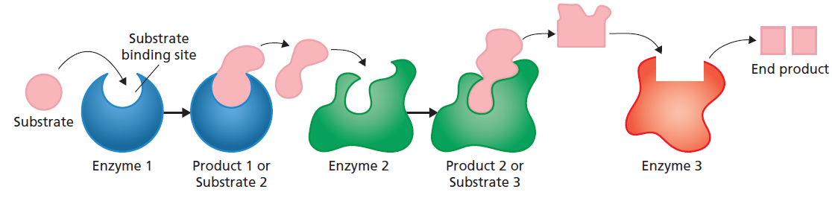
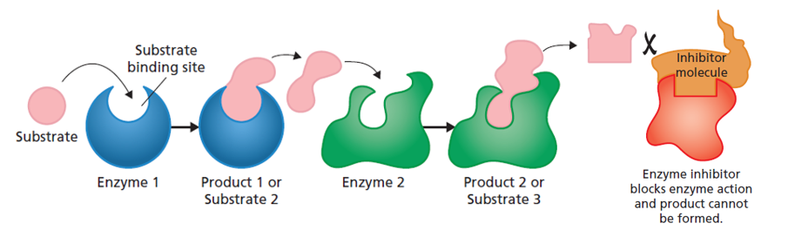
Regulating cellular processes
Cell signalling in context
Cellular processes ultimately rely on biochemical pathways to control various biological outcomes.
In biochemical pathways, a substrate can be modified by an enzyme to produce new products.
Figure 9.4

Slide 8
Regulating cellular processes
Cell signalling in context
Biochemical pathways can be up-regulated or down-regulated to meet demand.
Biochemical pathways can altered by changing
Substrate availability
Enzyme activity (expression, conformation, binding of activators and
inhibitors)
Substrate binding to the enzyme (inhibitors can prevent this)

Slide 9
Signalling molecules (from Chapter 8)
Detecting and responding to signals
When a stimulus is detected, a signal is usually produced, which contains the information needed to respond appropriately.
Detect
Sensors monitor and detect variation from the homeostatic range
Signal
Target
The signal is relayed to a target effector, which brings about the required response.
Respond
Effectors respond to maintain homeostasis

Slide 10
Signalling molecules
Detecting and responding to signals
At the cellular level,
Detect
Signal
Signalling molecules are responsible for transmitting the signal
Target
Receptors on a target cell bind the signalling molecule and initiate the cell’s response
Respond
A response often involves changes to transcription factor activity to up-regulate or down-regulate gene transcription

Slide 11
Signalling molecules
Detecting and responding to signals
Receptors are essential for cell signalling, also called signal transduction.
Like a key opening a lock, only the right receptor can bind to a signalling molecule. This is binding specificity.
Cells that express the right receptor for a signalling molecule are its target cells. Other cells will not respond to the signal.

Slide 12
Signalling molecules
Detecting and responding to signals
Signalling molecules can be proteins, ions, lipids, phospholipids, amino acids, or gases.
Cell signalling controls many cellular processes and signalling molecules can belong to many classes, but we will focus on hormone signalling to illustrate some concepts of cell signalling.
Like many signalling molecules, hormones can vary in their form and properties. They can vary in:
Size
Charge
Water solubility
These factors will affect a hormone’s ability to cross plasma membranes.

Slide 13
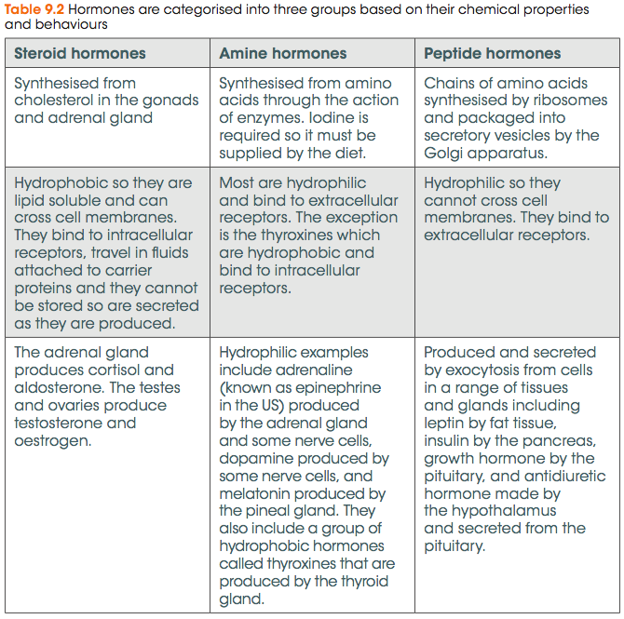
Signalling molecules
Detecting and responding to signals
Hormones can be broadly classed into three groups, each with different properties.

Slide 14
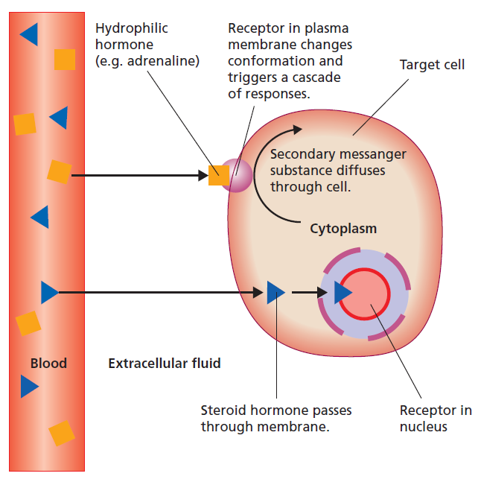
Signalling molecules
Detecting and responding to signals
An example of a peptide hormone is adrenaline, which cannot pass through the plasma membrane.
It binds to an extracellular receptor whose intracellular domain initiates intracellular signalling pathways.
Figure 9.2

Slide 15
Transduction of the signal
Detecting and responding to signals
The production of cAMP is an example of part of an intracellular signalling cascade, which relays the information conveyed by the signalling molecule within the cell. This type of cascade is often called signal transduction.
Detect
Signal
Target
Signal transduction pathways within the cell carry
the information and allow coordination of a response
to the signal.
Respond

Slide 16
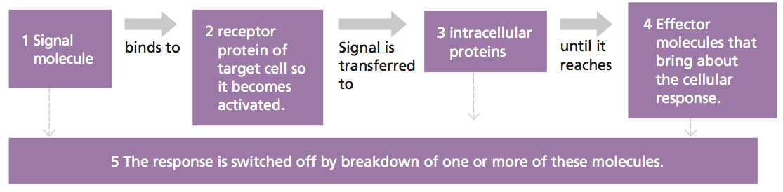
Transduction of the signal
Detecting and responding to signals
In general, the process of signal transduction can be summarised as follows:
Other signal transduction pathways activated
Fine tuning or alteration of cellular response
Other signal molecules
Signals act collectively to influence cell activity.
Figure 9.6

Slide 17
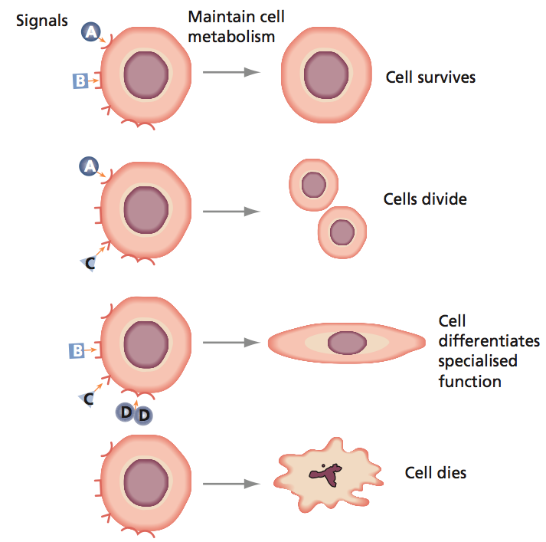
Transduction of the signal
Detecting and responding to signals
Signals act collectively to influence cell activity.
The way a cell responds is determined by:
Its expression of receptors
Its expression of molecules involved in signal transduction
The presence or absence of other signalling molecules and its receptors for those
Figure 9.7

Slide 18
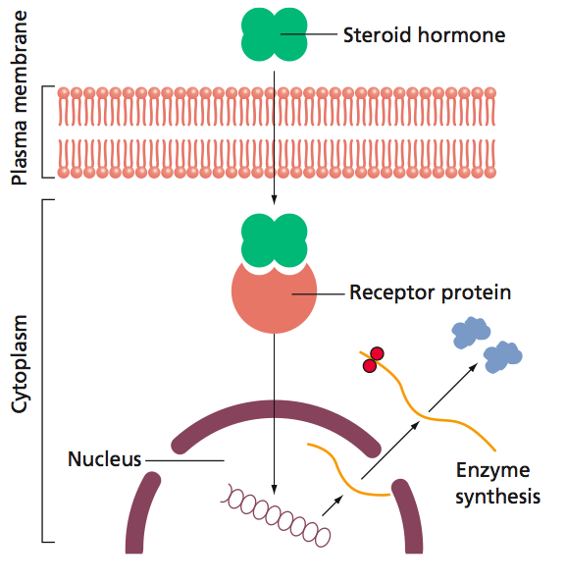
Intracellular receptors
Detecting and responding to signals
Steroid hormones are small and hydrophobic.
They easily pass through the plasma membrane.
Their receptors are intracellular and are often transcription factors.
Signal transduction pathways in this circumstance are very simple.
Figure 9.8

Slide 19
Intracellular receptors
Detecting and responding to signals
An example of a steroid hormone is cortisol.
Glucagon production by pancreas
Low glucose
Adrenal gland produces cortisol
Cortisol binds a TF that changes conformation when cortisol is bound
It then becomes able to activate transcription of enzymes that build glucose
Stimulates glucose synthesis from amino acids and glycerol in liver
Stimulates release of fatty acids from adipose tissue
Inhibits glucose uptake by muscle and adipose tissue

Slide 20
Extracellular receptors
Detecting and responding to signals
Large or charged signalling molecules cannot pass through plasma membranes
E.g. peptide hormones and hydrophilic amines
Large or charged signalling molecules bind to extracellular receptors embedded in the cell membrane.
Extracellular receptors are grouped into three categories:
1. Ion channel receptors
When bound by a signalling molecule, open to allow influx or
efflux of ions.
2. G protein-coupled receptors
When bound by a signalling molecule, release a G protein
from their intracellular domain, allowing it to activate other
proteins in the pathway
3. Tyrosine kinase receptors
Binding of a signalling molecule activates enzyme activity of
the receptor itself, which can initiate signalling

Slide 21
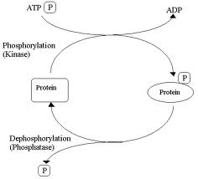
Extracellular receptors
Detecting and responding to signals
Tyrosine kinase receptors are named such because they have kinase activity.
Kinases are enzymes that can remove a phosphate group from an adenosine triphosphate (ATP) molecule to phosphorylate a protein substrate.
Protein phosphorylation is a common way to switch on or off the activity of proteins. It can cause a change in conformation and charge in active domains or binding sites.

Slide 22
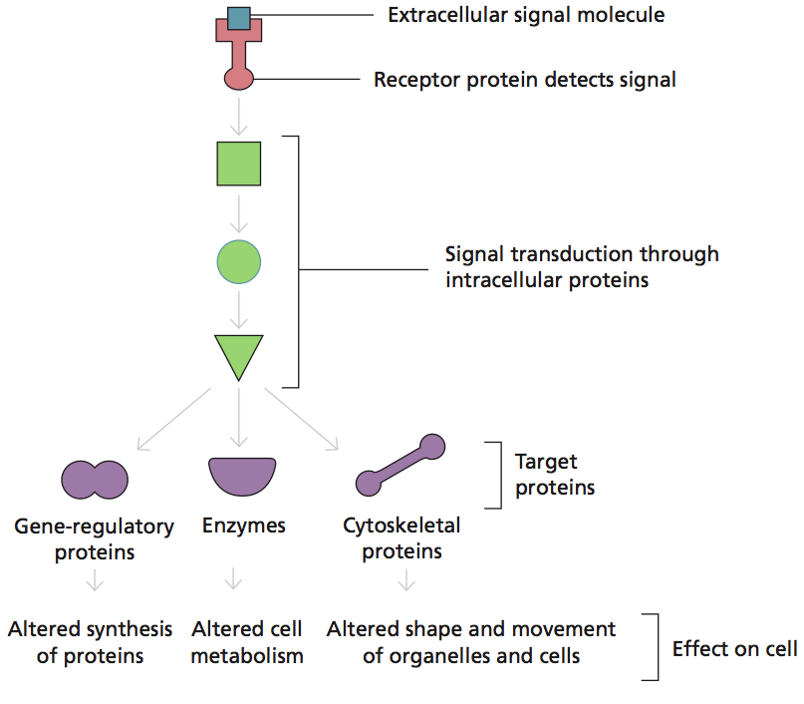
Extracellular receptors
Detecting and responding to signals
Kinases are frequently part of signal transduction pathways, acting in a cascade of events that relay the signal within the cell.
Figure 9.9

Slide 23

Second messengers
Detecting and responding to signals
Signal transduction pathways in cells utilise second messengers within the
signalling cascades.
Second messengers relay the signal and amplify it within the cell.
Each enzyme can produce many second messengers.

Slide 24
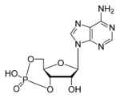
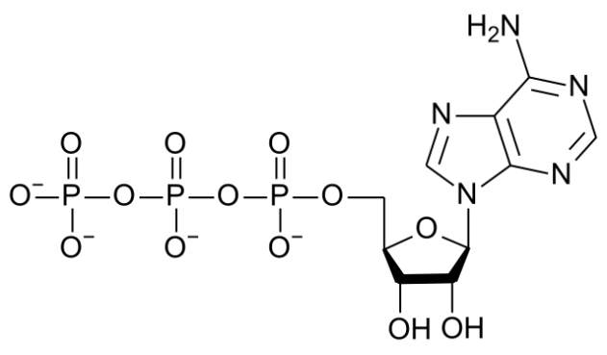
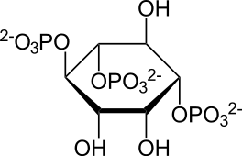
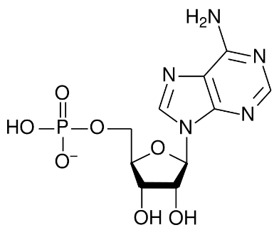
Second messengers
Detecting and responding to signals
There are three major second messenger systems now recognised in cells:
Ions
e.g. Ca2⁺
Cyclic
nucleotides
e.g. cAMP
Lipid-derived
molecules
e.g. inositol
triphosphate
cAMP
Adenylate cyclase
ATP
Phospho-diesterase
PPi
AMP

Slide 25
Effector proteins
Detecting and responding to signals
The cellular response can occur through:
activation of proteins within the cell
changing the expression of genes within the cell (up- or down-regulation).
Effector proteins that elicit a response include:
gene regulators e.g. to switch on a gene that stimulates differentiation
ion channels e.g. to allow influx of potassium
enzymes e.g. to breakdown pro-apoptotic proteins and protect against death
parts of the cytoskeleton e.g. to induce migration or exocytosis of vesicles.

Slide 26
Terminating the signal
Detecting and responding to signals
Controlling the magnitude and duration of signal transduction is important for:
correct cell functioning
the maintenance of homeostasis.
A common way of controlling signal transduction is by the activity of phosphatases, which dephosphorylate signaling proteins.
Phosphatases antagonise the activity of kinases.

Slide 27
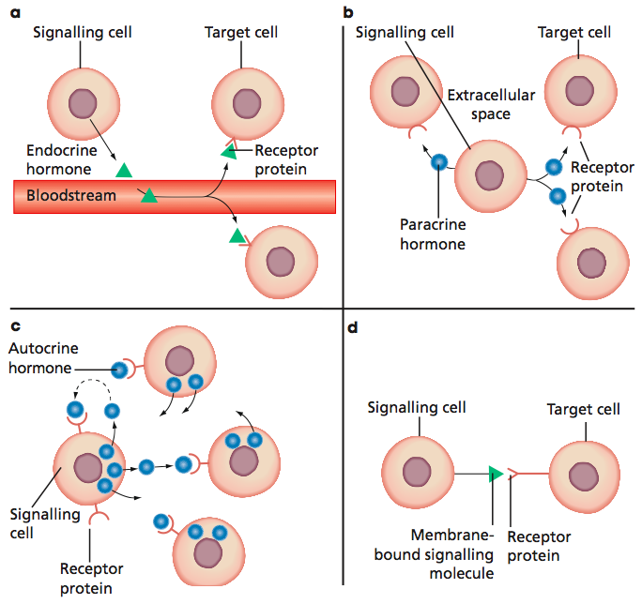
Classifying chemical signals
Signaling in animals
Signals can be classified based on the distance they travel and the cells they act on.
Endocrine
Paracrine
Contact-dependent
Autocrine
Figure 9.10

Slide 28
Contact-dependent signaling
Signaling in animals
This requires cell-to-cell contact. It is important in:
embryonic development
maintaining the size and architecture of organs
Apoptosis.
Contact-dependent signaling usually involves adhesion proteins to detect that contact is made.
Contact inhibition of cell growth is observed in wound healing and is important for preventing tumour development.

Slide 29
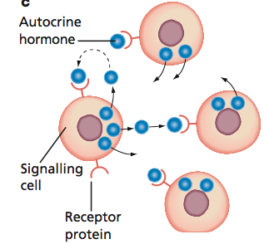
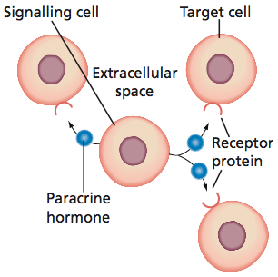
Autocrine and paracrine signaling
Signaling in animals
Autocrine signaling occurs when a signaling protein secreted by a cell acts on the same cell or cells of its kind.
Paracrine signaling occurs when a signal travels over a very short distance to affect nearby target cells (cells of a different kind to the signaling cell).
Figure 9.10

Slide 30
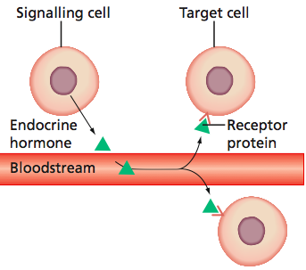
Endocrine signaling
Signaling in animals
Endocrine hormones circulate through the blood and lymphatic system, affecting only target cells that express the receptor for the hormone.
Figure 9.10

Slide 31
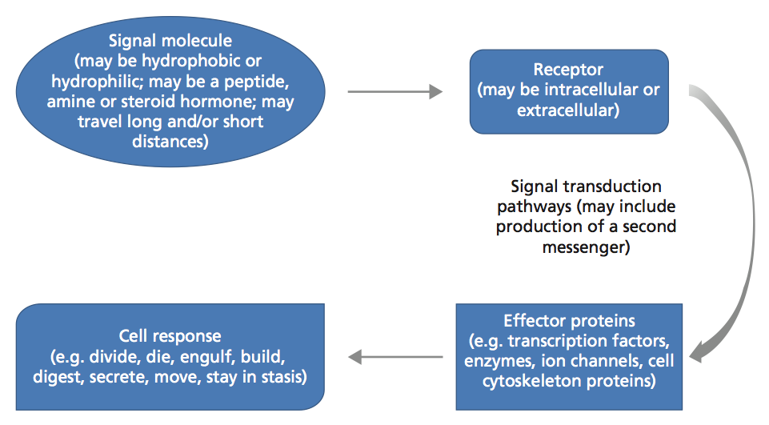
Stimulus-response model
Signaling in animals
Stimulus-response models can be used to represent signaling pathways in cells.
Figure 9.13

Slide 32
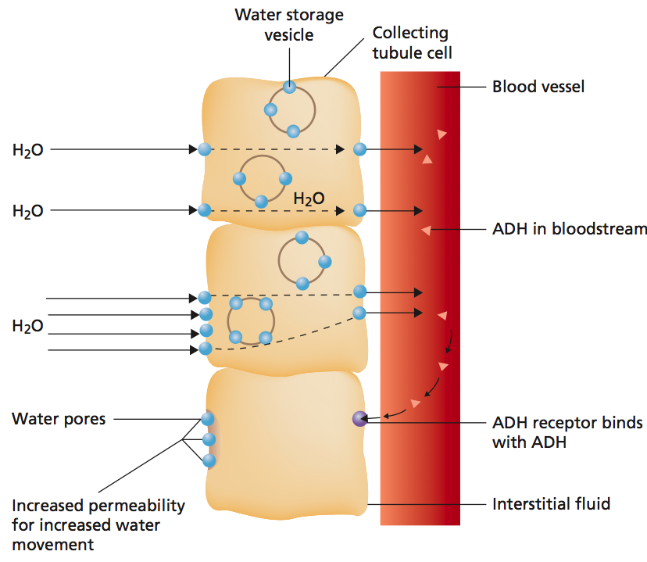
Stimulus-response model
Signaling in animals
An example of a stimulus-response model is the signaling pathway of antidiuretic hormone (vasopressin) in kidney collecting tubule cells.
Stimulus: ADH binds to a receptor on the cell.
This causes a second messenger, cAMP, to be made in the cell.
cAMP activates protein kinases, which phosphorylate proteins that stimulate exocytosis of vesicles containing aquaporin channels.
Water leaves the kidney, moving into the blood. cAMP in the cell is degraded and over time the aquaporin channels also break down.

Slide 33
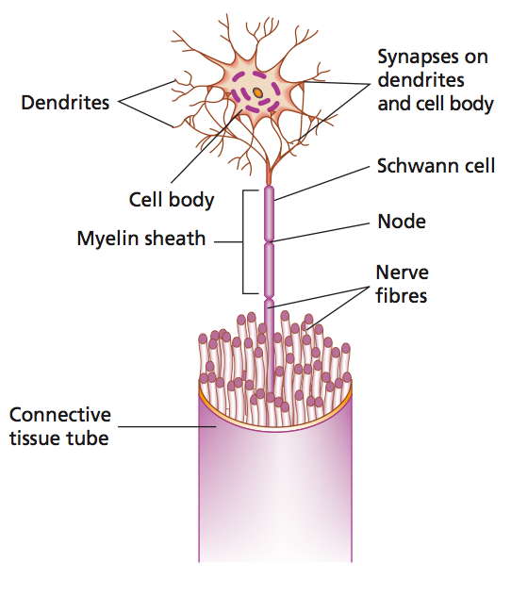
Communication through electrical signals
Electrical signals
Communication in the nervous system relies on electrical signals sent along nerve cells.
The signals can be initiated by many stimuli including physical stimulation or chemical signals.
Initiation of an electrical impulse begins with ion channels opening in the cell membrane, allowing the movement of sodium and potassium over the membrane.
Figure 8.5

Slide 34
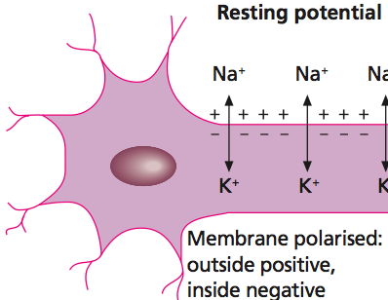
Communication through electrical signals
Electrical signals
The cell membrane of an axon is polarised. At rest, the inside of an axon is negatively charged relative to the outside. This is the resting potential.
Sodium-potassium pumps pump out three sodium ions in exchange for two potassium ions in to the cell.
The overall effect is a loss of positive ions from the cell.
Figure 9.15

Slide 35
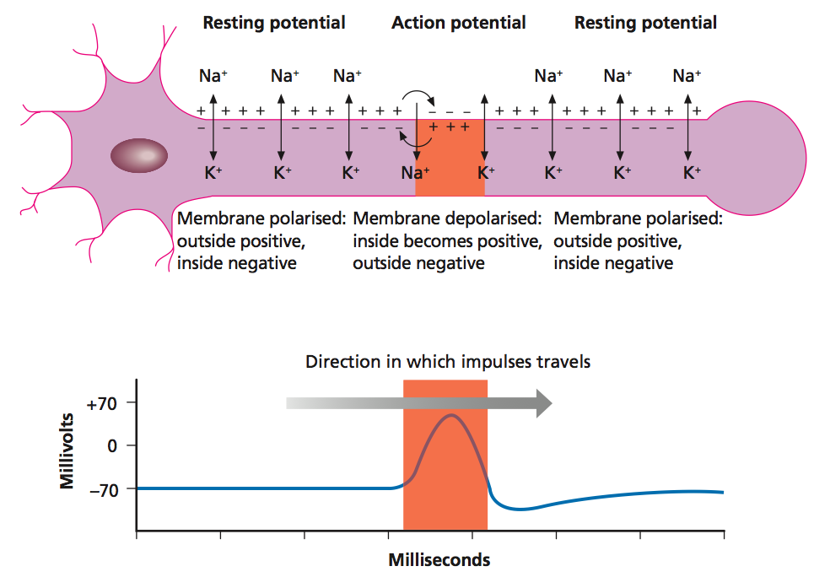
Communication through electrical signals
Electrical signals
When a signal is initiated, the membrane becomes depolarised as positive ions flood into the cell.
This is called an action potential.
Depolarisation causes nearby ion channels to open, causing the action potential to move along the axon.
Figure 9.15

Slide 36
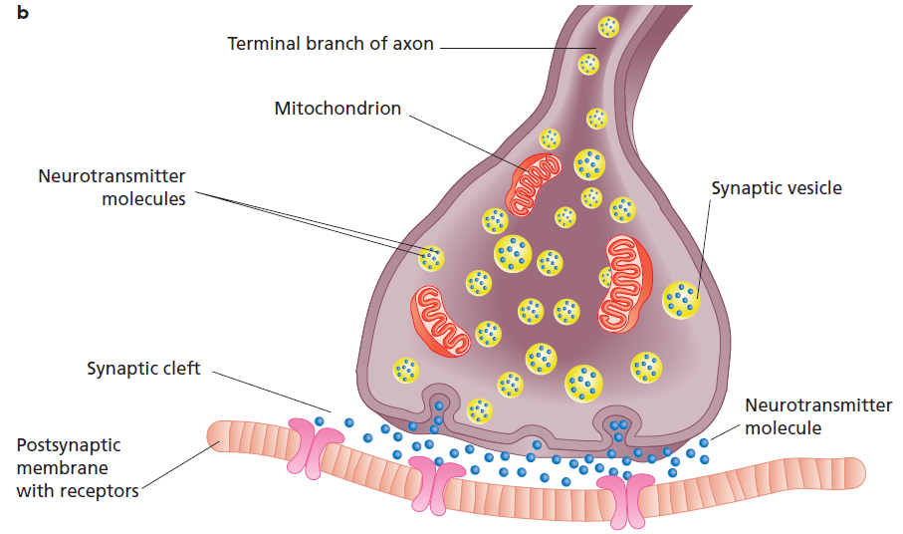
Neurotransmitters
Electrical signals
When the action potential reaches the end of the axon, how is the signal transferred to the next neuron?
An action potential reaching a synaptic knob causes release of vesicles that contain a neurotransmitter.
Figure 9.16

Slide 37
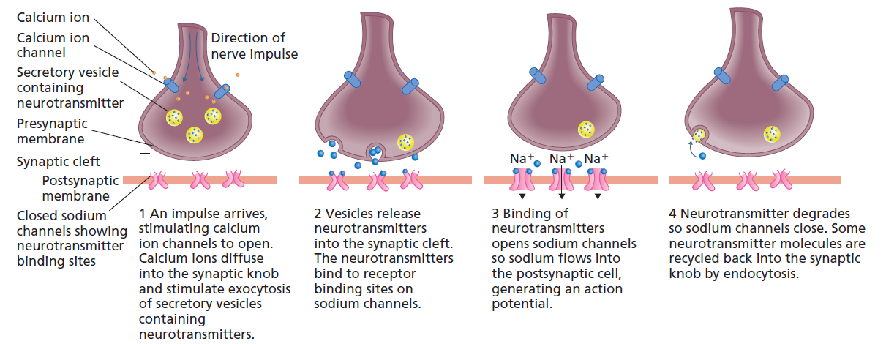
Neurotransmitters
Electrical signals
Binding of the neurotransmitter to receptors on the post-synaptic membrane cause depolarisation of the membrane, which initiates an action potential.
Excess neurotransmitter in the synaptic cleft is quickly recycled or degraded.
Figure 9.17

Slide 38
Neurotransmitters
Electrical signals
Neurotransmitter release at a single synapse is not usually enough to stimulate an action potential.
Multiple synapses usually fire at once.
After firing, neurotransmitter stocks may be depleted and the neuron may be fatigued, unable to signal for a time until supplies are restored.
Some neurotransmitters have a regulatory role, causing the post-synaptic membrane to become more polarised than usual.
This makes an action potential harder to generate.
A common neurotransmitter is acetylcholine. It is usually degraded by cholinesterase.
Some insecticides inactivate cholinesterase to cause muscle spasms.

Slide 39
Neurotransmitters
Electrical signals
Some neurotransmitters are very similar to hormones, e.g. noradrenaline is similar to adrenaline.
Neurotransmitters are released in response to pre-synaptic depolarisation and their specific receptors are on the post-synaptic membrane.
Some signaling molecules can be both hormones and neurotransmitters, e.g. ADH and oxytocin.

Slide 40
Examples of failures in cell communication
When cell communication goes wrong
Most diseases are caused by failures in cell communication.
Example | Result
Type I diabetes | Cells in pancreas that secrete insulin are destroyed, leading to high blood glucose Insulin can be injected to restore blood glucose homeostasis.
Type I diabetes | The insulin receptor no longer signals in response to insulin. Patients are ‘insulin resistant’ and have to manage their diets carefully.
Parkinson’s disease | Impairment of dopamine-producing cells. Low dopamine causes tremor.
Multiple sclerosis | Myelin sheath cells are destroyed by the immune system. The speed of impulses is slowed and leads to impaired motor function and other CNS problems.

